Slide 1
Today
Overview of all the thermodynamic surfaces we’ve worked with this semester
Recap weeks 10-14

Slide 2
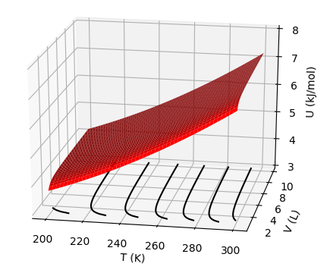


U(T,V) as a thermodynamic surface
$${\left(\frac{∂U}{∂T}\right)}_{V}$$
$${\left(\frac{∂U}{∂V}\right)}_{T}$$
$$dU=C_{V}dT+π_{T}dV$$

Slide 3
U(T,V) as a thermodynamic surface
$${\left(\frac{∂U}{∂T}\right)}_{V}$$
$${\left(\frac{∂U}{∂V}\right)}_{T}$$
$$dU=C_{V}dT+π_{T}dV$$

Slide 4
U(T,V) as a thermodynamic surface
$${\left(\frac{∂U}{∂T}\right)}_{V}$$
$${\left(\frac{∂U}{∂V}\right)}_{T}$$
$$dU=C_{V}dT+π_{T}dV$$

Slide 5
U(T,V) as a thermodynamic surface
$${\left(\frac{∂U}{∂T}\right)}_{V}$$
$${\left(\frac{∂U}{∂V}\right)}_{T}$$
$$dU=C_{V}dT+π_{T}dV$$
As temperature goes up, Total energy (U) goes up

Slide 6
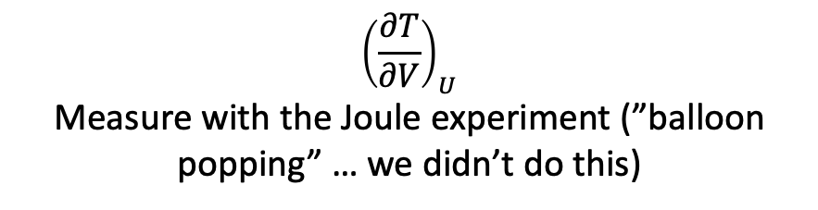
U(T,V) as a thermodynamic surface
$${\left(\frac{∂U}{∂T}\right)}_{V}$$
$${\left(\frac{∂U}{∂V}\right)}_{T}$$
$$dU=C_{V}dT+π_{T}dV$$
$${\left(\frac{∂T}{∂V}\right)}_{U}$$
Measure with the Joule experiment (”balloon popping” … we didn’t do this)

Slide 7
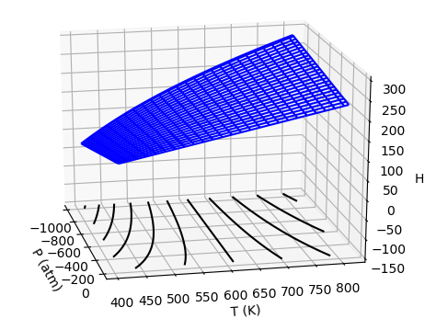


H(T,P) as a thermodynamic surface
$${\left(\frac{∂H}{∂T}\right)}_{P}$$
$${\left(\frac{∂H}{∂P}\right)}_{T}$$
Pressure
Temperature
$$dH=C_{P}dT+μ_{T}dP$$

Slide 8
H(T,P) as a thermodynamic surface
$${\left(\frac{∂H}{∂T}\right)}_{P}$$
$${\left(\frac{∂H}{∂P}\right)}_{T}$$
Pressure
Temperature
$$dH=C_{P}dT+μ_{T}dP$$

Slide 9
H(T,P) as a thermodynamic surface
$${\left(\frac{∂H}{∂T}\right)}_{P}$$
$${\left(\frac{∂H}{∂P}\right)}_{T}$$
Pressure
Temperature
$$dH=C_{P}dT+μ_{T}dP$$
As temperature goes up, Enthalpy (H) goes up

Slide 10
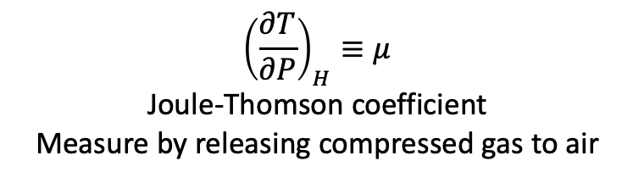
H(T,P) as a thermodynamic surface
$${\left(\frac{∂H}{∂T}\right)}_{P}$$
$${\left(\frac{∂H}{∂P}\right)}_{T}$$
Pressure
Temperature
$$dH=C_{P}dT+μ_{T}dP$$
$${\left(\frac{∂T}{∂P}\right)}_{H}≡μ$$
Joule-Thomson coefficient
Measure by releasing compressed gas to air

Slide 11
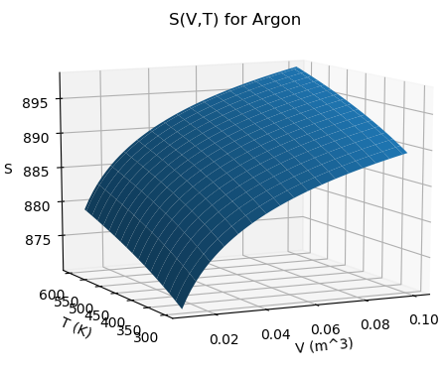



S(T,V) as a thermodynamic surface
$${\left(\frac{∂S}{∂T}\right)}_{V}$$
$${\left(\frac{∂S}{∂V}\right)}_{T}$$
Temperature
Volume
$$dS=\frac{C_{V}}{T}dT+\frac{α_{P}}{κ_{T}}dV$$

Slide 12
S(T,V) as a thermodynamic surface
$${\left(\frac{∂S}{∂T}\right)}_{V}$$
$${\left(\frac{∂S}{∂V}\right)}_{T}$$
Temperature
Volume
$$dS=\frac{C_{V}}{T}dT+\frac{α_{P}}{κ_{T}}dV$$
As volume goes up, Entropy (S) goes up

Slide 13
S(T,V) as a thermodynamic surface
$${\left(\frac{∂S}{∂T}\right)}_{V}$$
$${\left(\frac{∂S}{∂V}\right)}_{T}$$
Temperature
Volume
$$dS=\frac{C_{V}}{T}dT+\frac{α_{P}}{κ_{T}}dV$$
As temperature goes up, Entropy (S) goes up

Slide 14
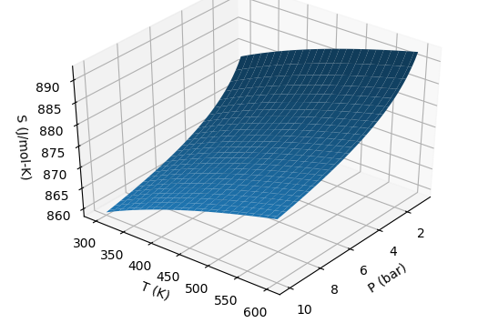



S(T,P) as a thermodynamic surface
$${\left(\frac{∂S}{∂P}\right)}_{T}$$
← Pressure
$${\left(\frac{∂S}{∂T}\right)}_{P}$$
Temperature
$$dS=\frac{C_{P}}{T}dT−α_{P}VdP$$

Slide 15
S(T,P) as a thermodynamic surface
$${\left(\frac{∂S}{∂P}\right)}_{T}$$
← Pressure
$${\left(\frac{∂S}{∂T}\right)}_{P}$$
Temperature
$$dS=\frac{C_{P}}{T}dT−α_{P}VdP$$
As pressure goes up, Entropy (S) goes down

Slide 16
S(T,P) as a thermodynamic surface
$${\left(\frac{∂S}{∂P}\right)}_{T}$$
← Pressure
$${\left(\frac{∂S}{∂T}\right)}_{P}$$
Temperature
$$dS=\frac{C_{P}}{T}dT−α_{P}VdP$$
As temperature goes up, Entropy (S) goes up

Slide 17
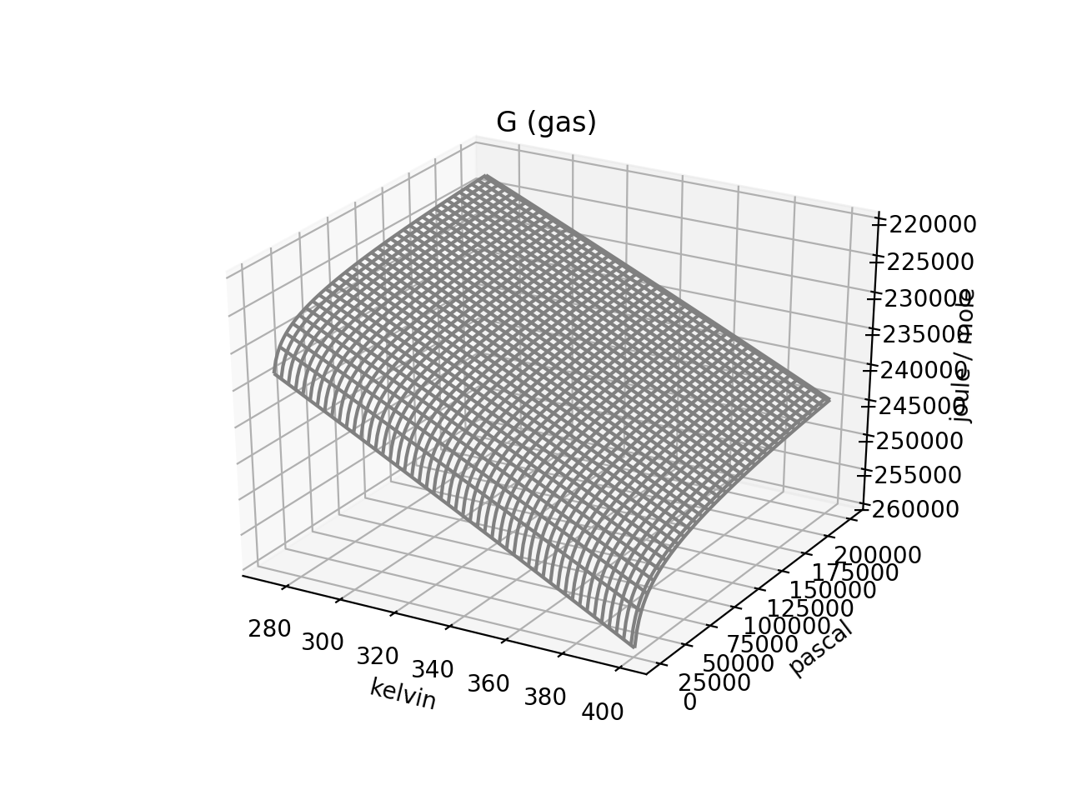


G(T,P) as a thermodynamic surface
$${\left(\frac{∂G}{∂T}\right)}_{P}$$
$${\left(\frac{∂G}{∂P}\right)}_{T}$$
Pressure
Temperature
$$dG=−SdT+VdP$$

Slide 18
S(T,P) as a thermodynamic surface
$${\left(\frac{∂G}{∂T}\right)}_{P}$$
$${\left(\frac{∂G}{∂P}\right)}_{T}$$
Pressure
Temperature
As pressure goes up, Gibbs energy (G) goes up
$$dG=−SdT+VdP$$

Slide 19
S(T,P) as a thermodynamic surface
$${\left(\frac{∂G}{∂T}\right)}_{P}$$
$${\left(\frac{∂G}{∂P}\right)}_{T}$$
Pressure
Temperature
$$dG=−SdT+VdP$$
As temperature goes up, Gibbs energy (G) goes down

Slide 20
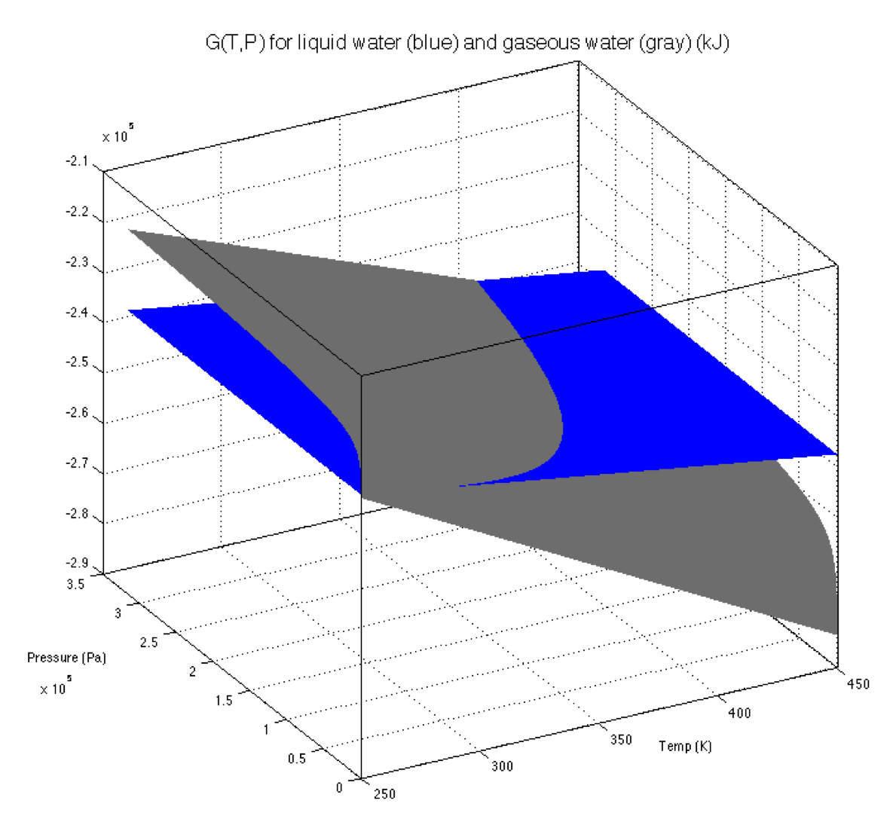
Intersecting G(T,P) thermodynamic surfaces
vapor
Liquid
← Pressure
Temperature

Slide 21
Intersecting G(T,P) thermodynamic surfaces
vapor
Liquid
← Pressure
Temperature
Along a phase boundary

Slide 22
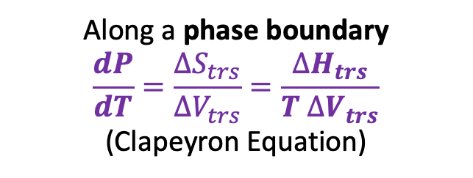
Intersecting G(T,P) thermodynamic surfaces
vapor
Liquid
← Pressure
Temperature
Along a phase boundary
$$\frac{dP}{dT}=\frac{∆S_{trs}}{∆V_{trs}}=\frac{∆H_{trs}}{T ∆V_{trs}}$$
(Clapeyron Equation)

Slide 23
Summary of measurable quantities

Slide 24
Week 10 – Entropy as a measure of choice (of where to go in space)
More choice about where to be → higher S

Slide 25
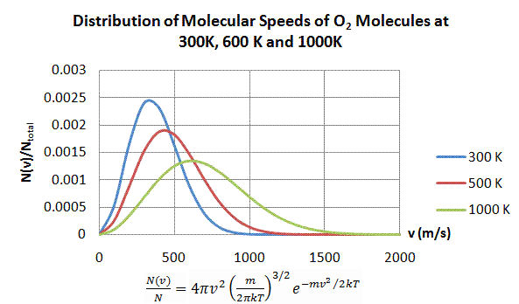
Week 10 – Entropy as a measure of choice (of how to distribute energy)
More choice about where to distribute energy → higher S

Slide 26
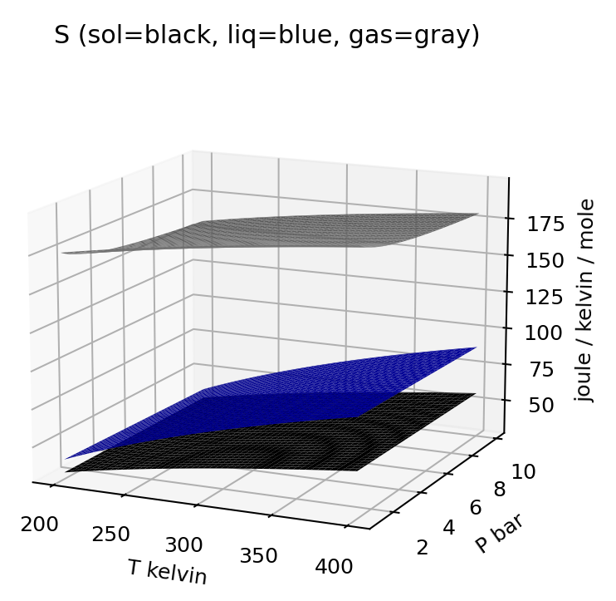

Week 10 – Entropy of different phases in T,P state space
$$dS=\frac{C_{P}}{T}dT−α_{P}VdP$$

Slide 27
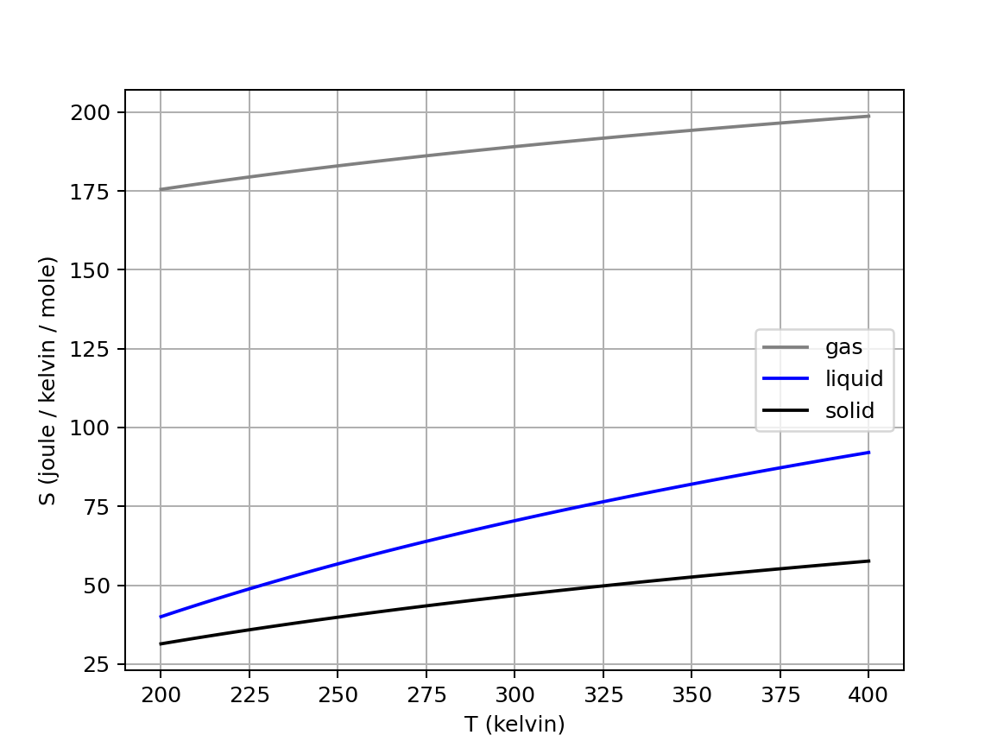
Week 10 – Isobars of the entropy of water at $P≈1 bar$

Slide 28
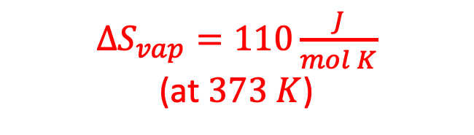
Week 10 – Entropy of vaporization of water
$∆S_{vap}=110\frac{J}{mol K}$
(at $373 K$)

Slide 29
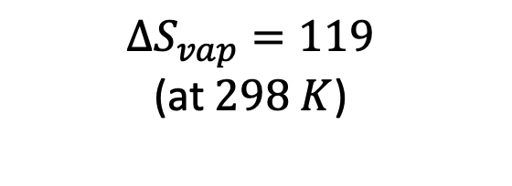
Week 10 – Entropy of vaporization of water
$∆S_{vap}=110\frac{J}{mol K}$
(at $373 K$)
$$∆S_{vap}=119$$
(at $298 K$)

Slide 30
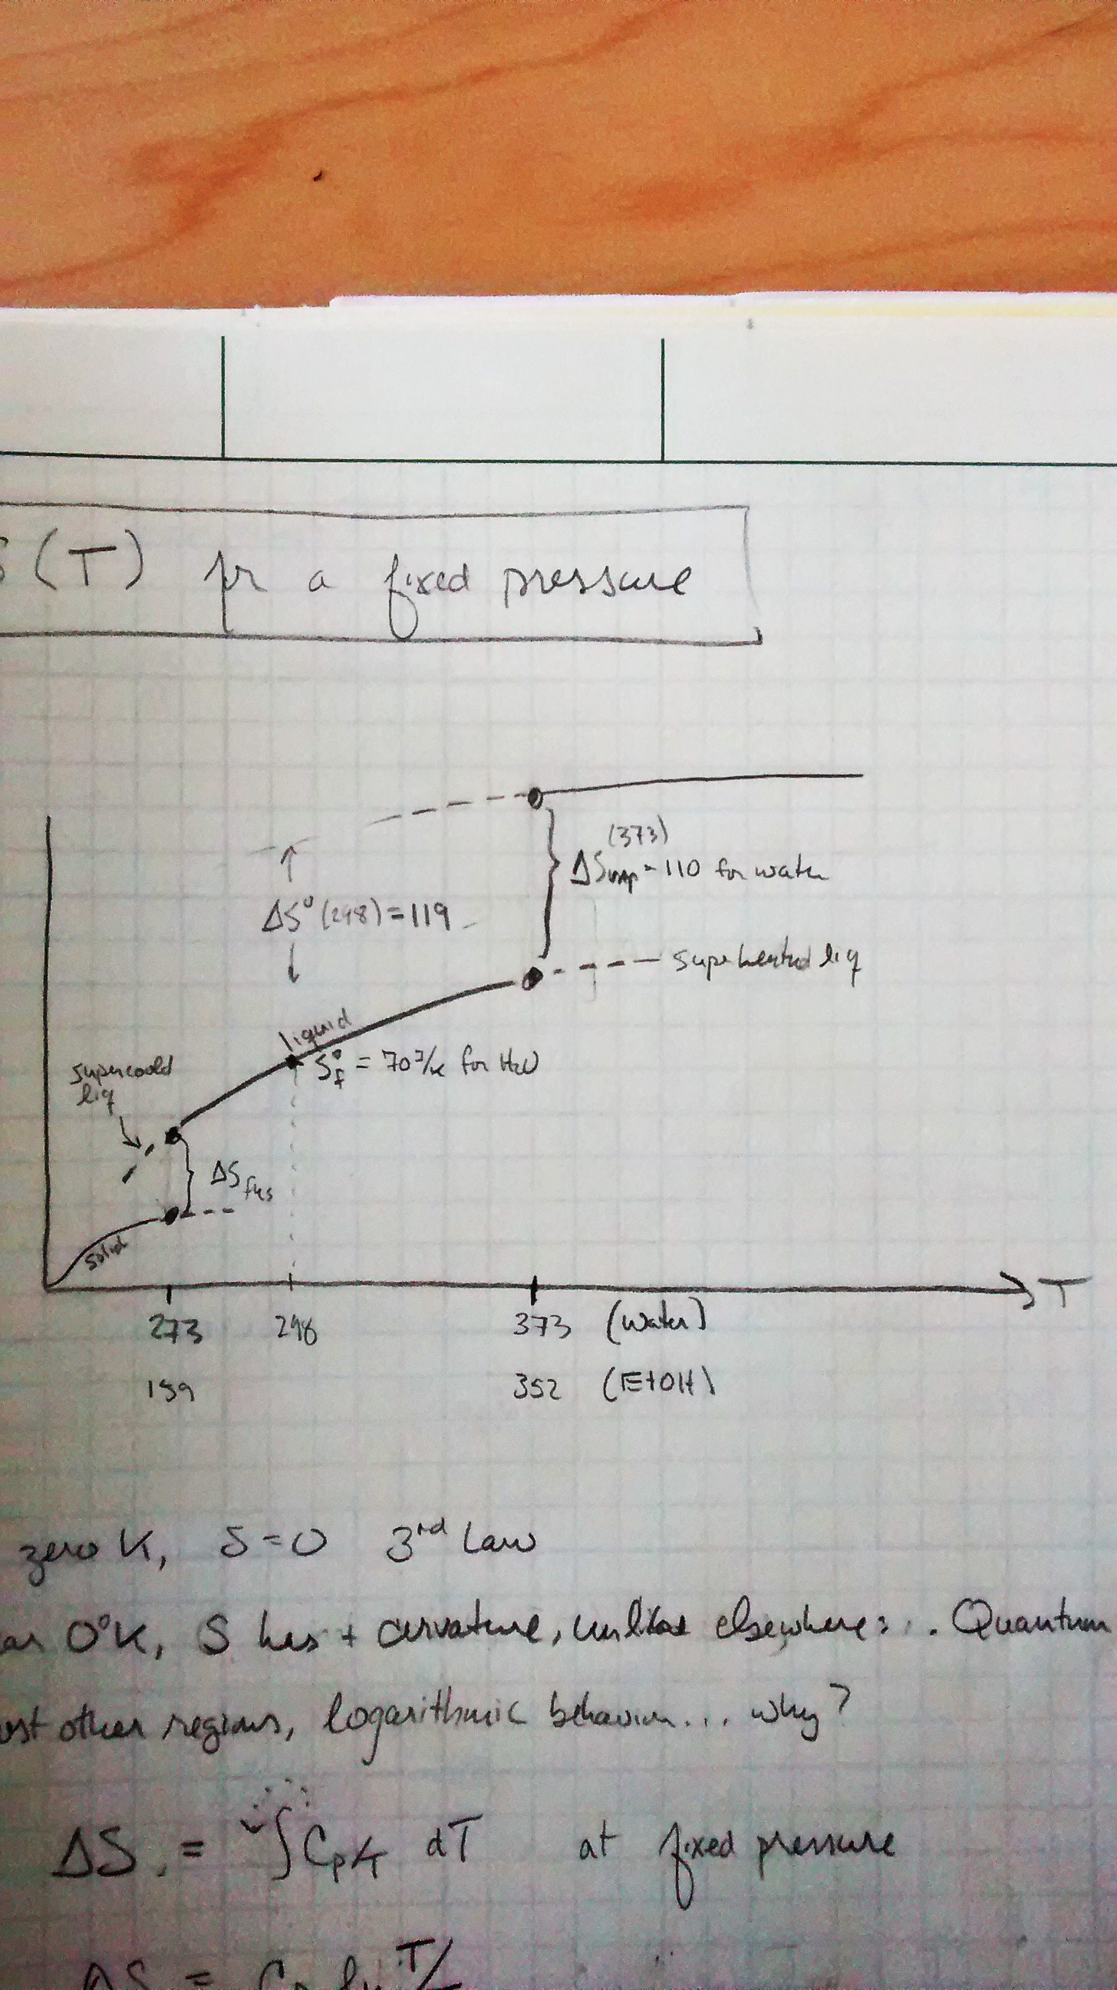
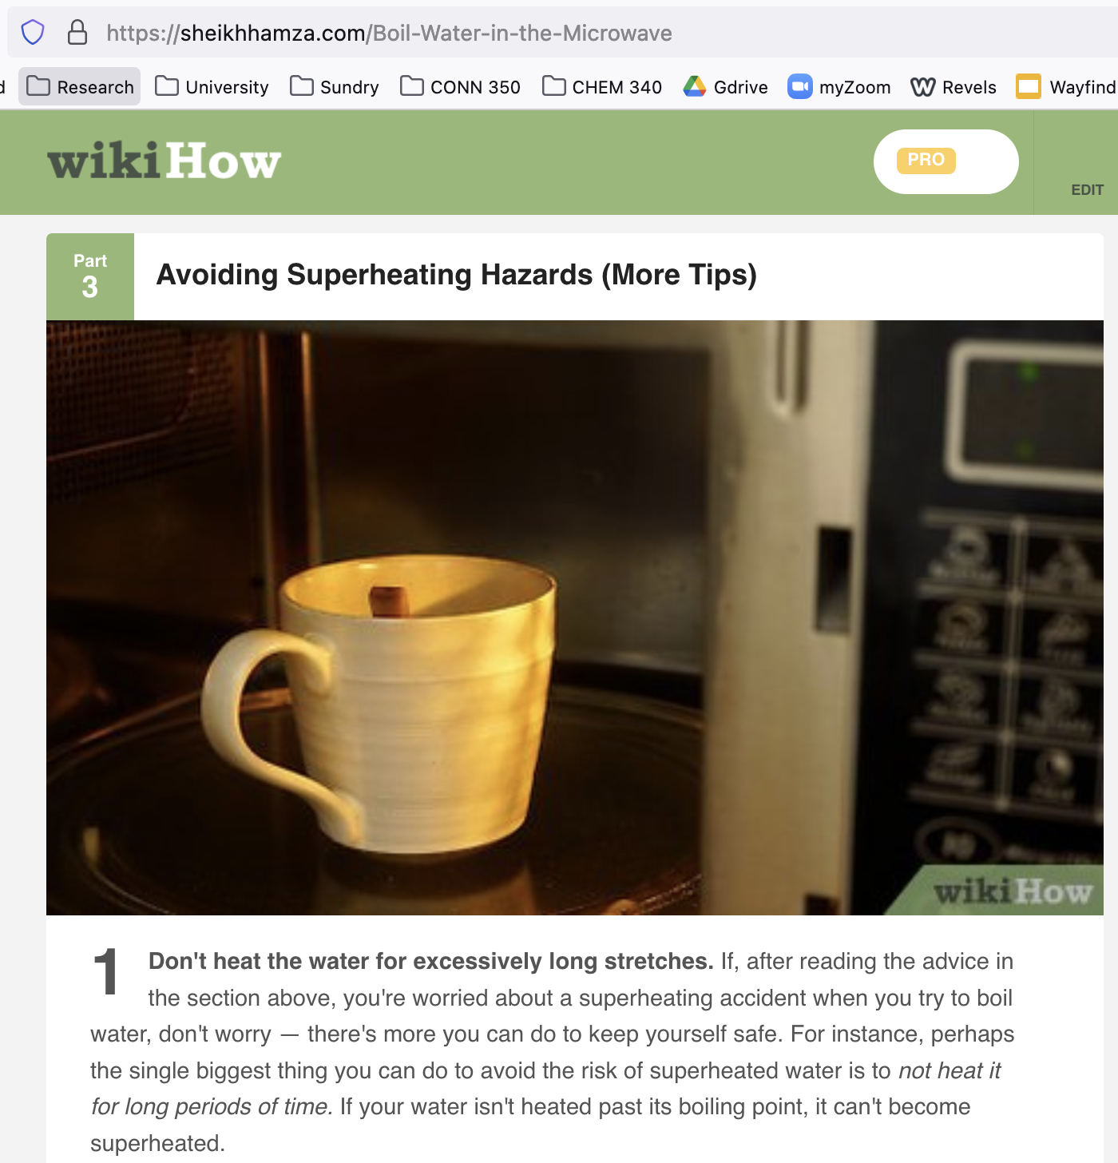
Week 10 – Supercooling and superheating
S

Slide 31
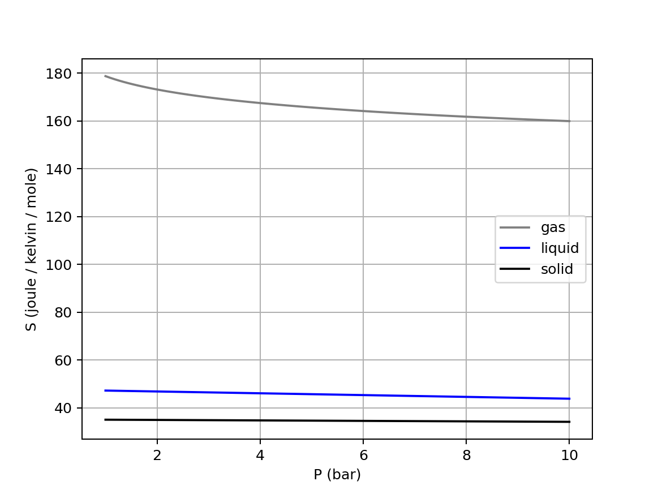

Week 10 – Isotherms of the entropy of water ($T≈298 K$)
$$dS=\frac{C_{P}}{T}dT−α_{P}VdP$$

Slide 32
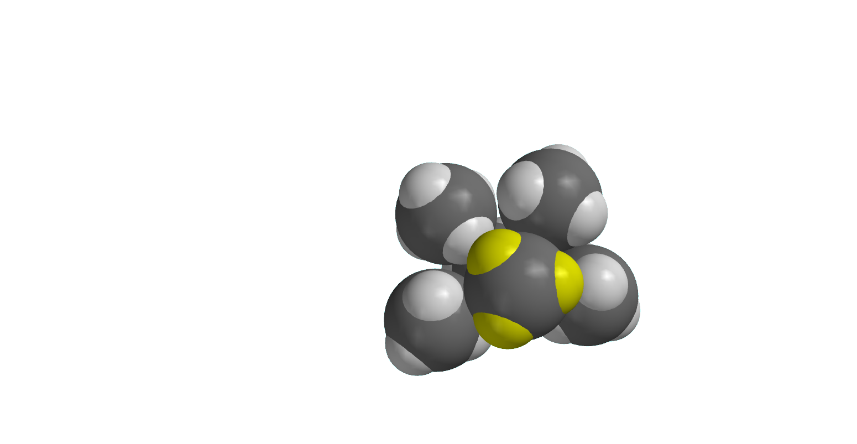
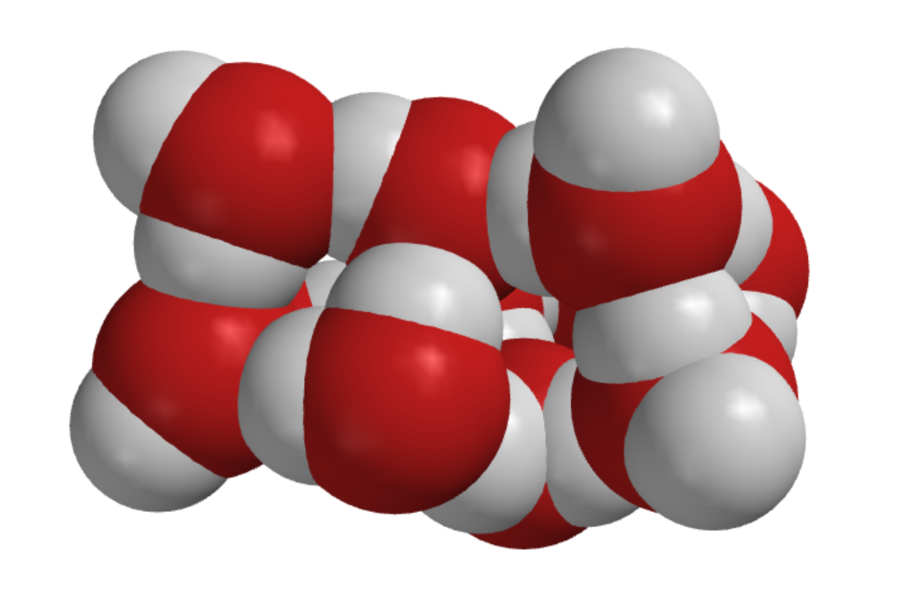
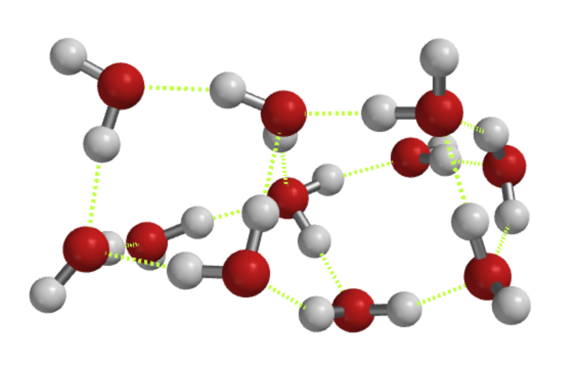
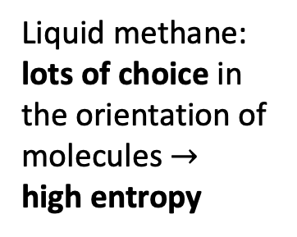
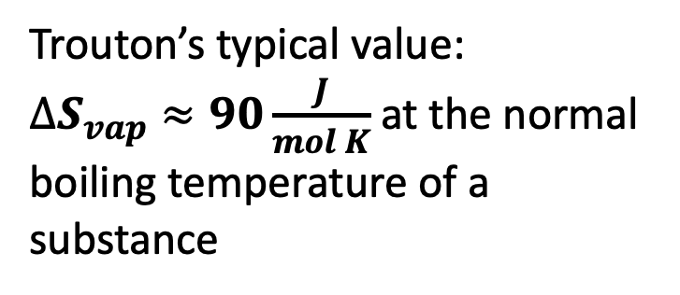
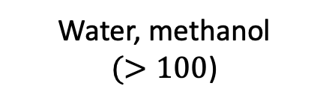
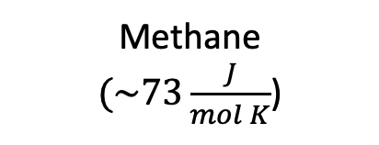
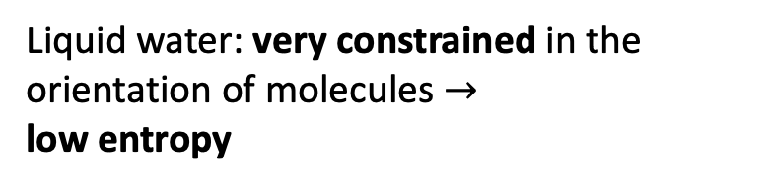
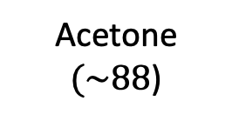
Week 10 – Why $∆S_{vap}$ of water is so big
Trouton’s typical value:
$∆S_{vap}≈90\frac{J}{mol K}$ at the normal boiling temperature of a substance
Methane
$(\sim 73\frac{J}{mol K}$)
Acetone
$(\sim 88$)
Water, methanol
$(>100$)
Liquid water: very constrained in the orientation of molecules $→$
low entropy
Liquid methane: lots of choice in the orientation of molecules $→$
high entropy
Notes:
https://slideplayer.com/slide/7362502/

Slide 33
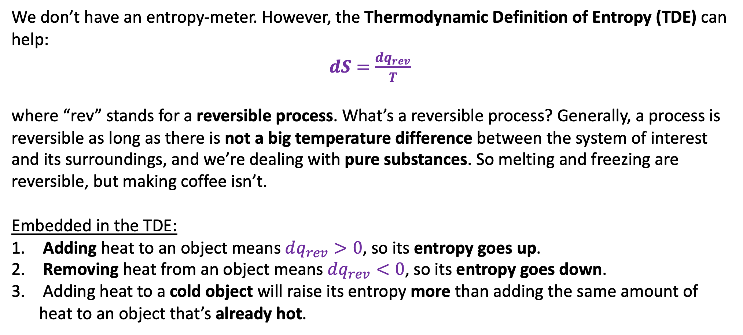
Week 10 – Thermodynamic Definition of Entropy (TDE)
We don’t have an entropy-meter. However, the Thermodynamic Definition of Entropy (TDE) can help:
$dS=\frac{dq_{rev}}{T}$
where “rev” stands for a reversible process. What’s a reversible process? Generally, a process is reversible as long as there is not a big temperature difference between the system of interest and its surroundings, and we’re dealing with pure substances. So melting and freezing are reversible, but making coffee isn’t.
Embedded in the TDE:
Adding heat to an object means $dq_{rev}>0$, so its entropy goes up.
Removing heat from an object means $dq_{rev}<0$, so its entropy goes down.
Adding heat to a cold object will raise its entropy more than adding the same amount of heat to an object that’s already hot.

Slide 34
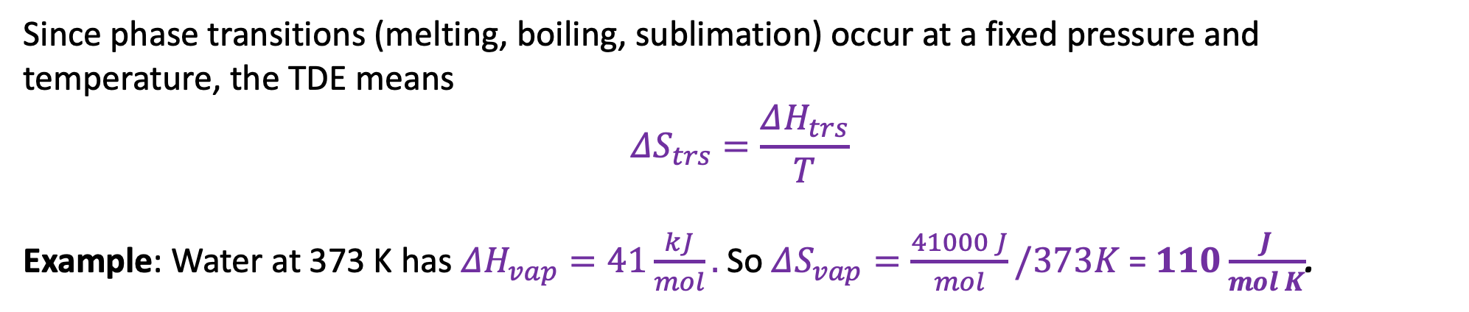
Week 10 – A great use of the TDE: to measure entropies of phase transitions
Since phase transitions (melting, boiling, sublimation) occur at a fixed pressure and temperature, the TDE means
$$ΔS_{trs}=\frac{ΔH_{trs}}{T}$$
Example: Water at 373 K has $ΔH_{vap}=41\frac{kJ}{mol}.$So $ΔS_{vap}=\frac{41000 J}{mol}/373K$ = $110\frac{J}{mol K}$.

Slide 35
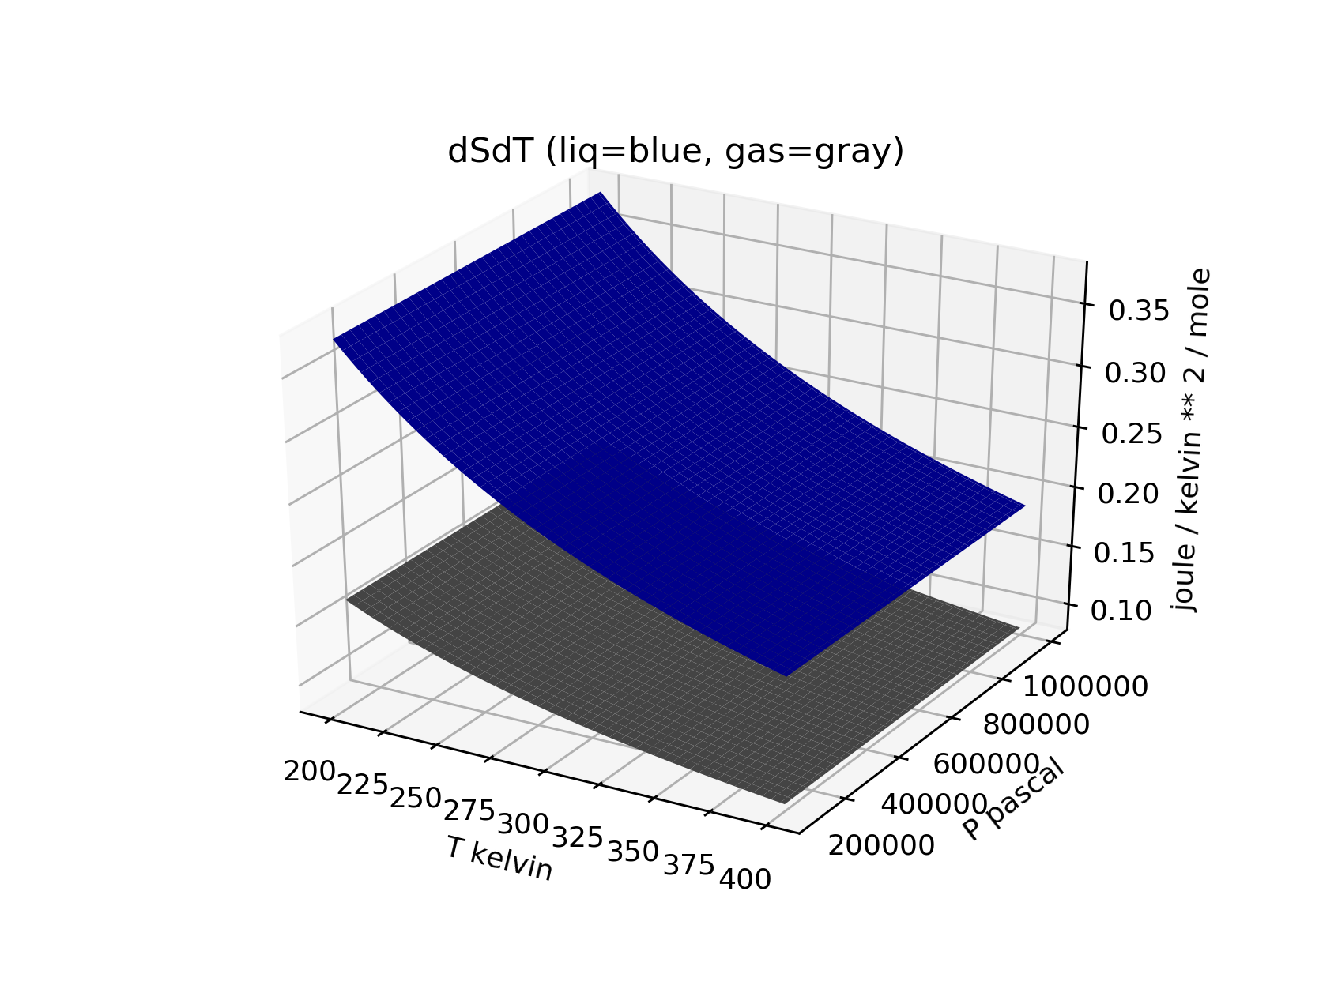
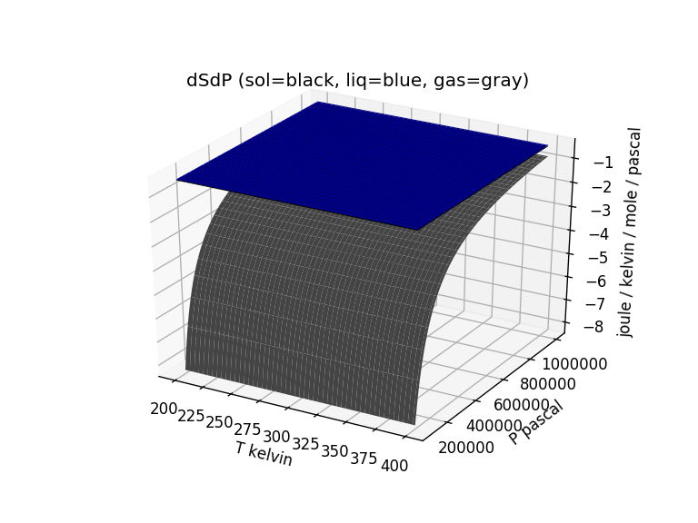
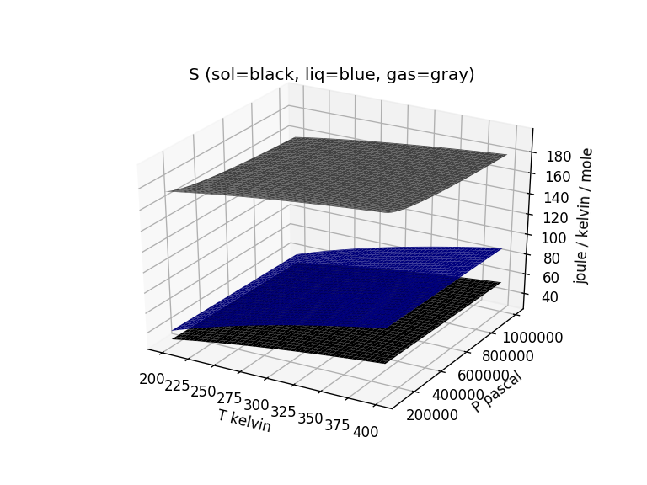
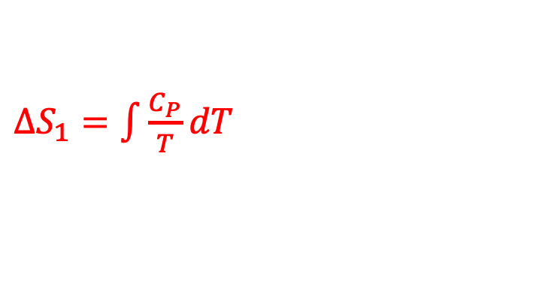
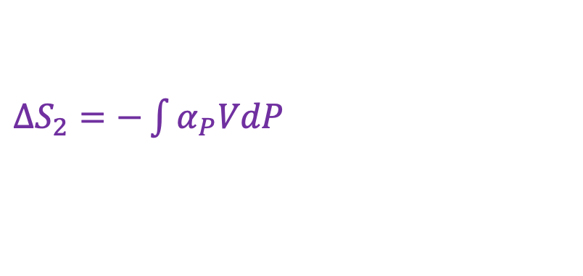
Week 10 – Constructing S(T,P) by integrating and the idea of path independence
${−α}_{P}V=$constant if liquid or solid
$\frac{C_{P}}{T}$
${−α}_{P}V= −\frac{R}{P}$ if a gas
$${−α}_{P}V$$
$∆S_{1}=\int{\frac{C_{P}}{T}dT}$
$∆S_{2}=−\int{α_{P}VdP}$
$${\left(\frac{∂S}{∂P}\right)}_{T}$$
$${\left(\frac{∂S}{∂T}\right)}_{P}$$
$S=∆S_{1}+∆S_{2}$+ $S_{f}^{o}$

Slide 36
Week 11 – Two parts of the entropy
The 2nd Law divides the question of spontaneity into two parts:
A system part that we can get at using differential equations of state for the entropy, and thermodynamic tables of entropy
A surroundings part that deals with the entropy change of the surroundings due to heat transfer, that we can get at using thermodynamic tables of enthalpy

Slide 37
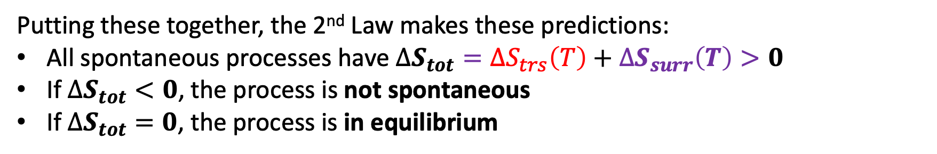
Week 11 – 2nd Law of Thermodynamics
Putting these together, the 2nd Law makes these predictions:
All spontaneous processes have $∆S_{tot}={∆S}_{trs}\left(T\right)+∆S_{surr}\left(T\right)>0$
If $∆S_{tot}<0$, the process is not spontaneous
If $∆S_{tot}=0$, the process is in equilibrium

Slide 38
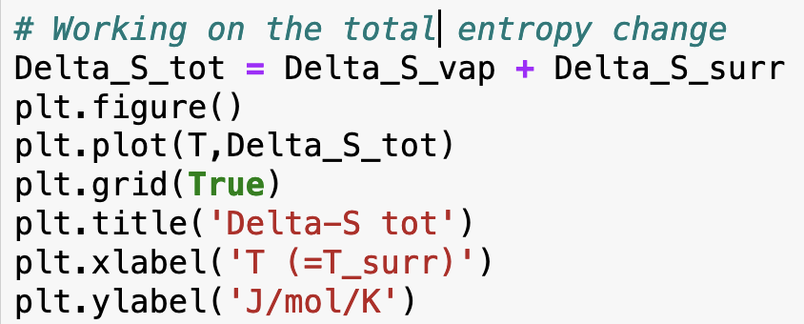
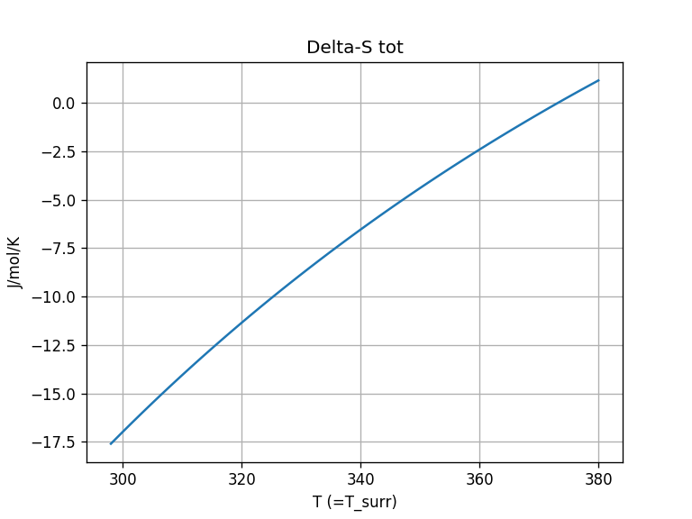
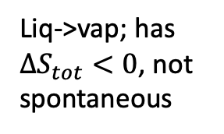
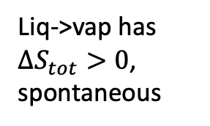
Week 11 – How you did that in Python
Liq->vap; has $∆S_{tot}<0$, not spontaneous
Liq->vap has $∆S_{tot}>0$, spontaneous

Slide 39
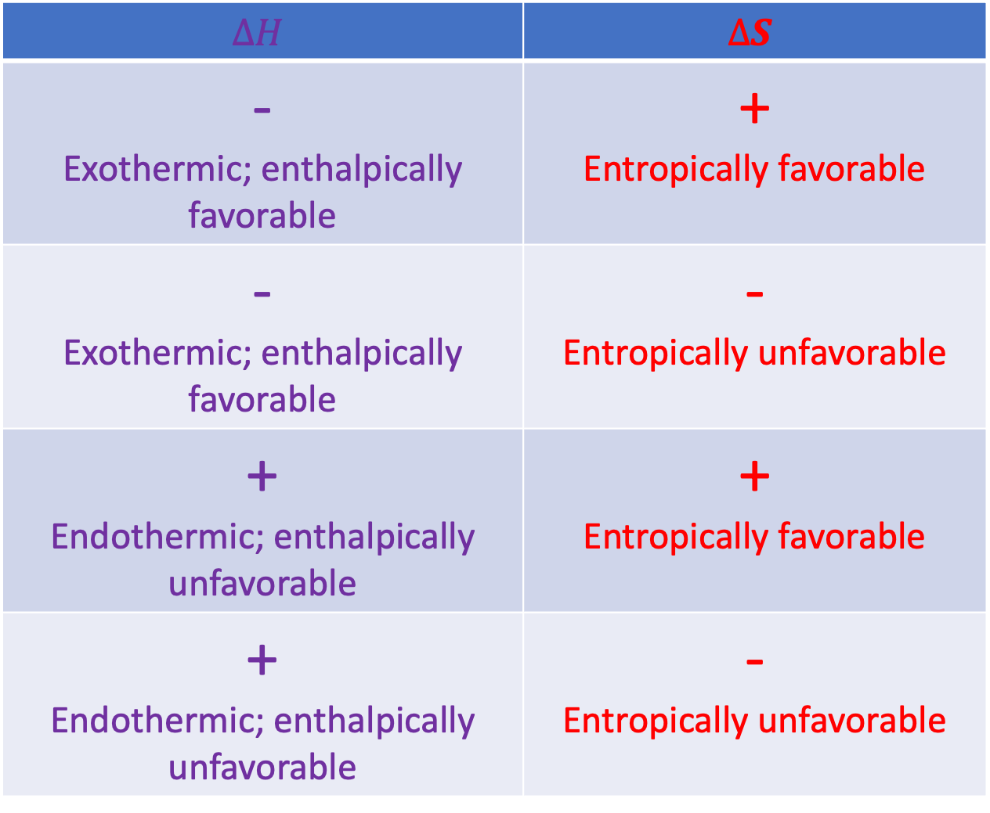
Week 11 – Systematizing the enthalpic/entropic favorability/unfavorability picture
$$∆H$$ | $$∆S$$
- Exothermic; enthalpically favorable | + Entropically favorable
- Exothermic; enthalpically favorable | - Entropically unfavorable
+ Endothermic; enthalpically unfavorable | + Entropically favorable
+ Endothermic; enthalpically unfavorable | - Entropically unfavorable

Slide 40
Week 11 – A caveat: the entropy of mixing
$∆S_{tot}=∆S+∆S_{surr}>0$ for all spontaneous processes. This is the 2nd Law
All about entropy changes of the surroundings due to heat going in/out

Slide 41
Week 11 – A caveat: the entropy of mixing
$∆S_{tot}=∆S+∆S_{surr}>0$ for all spontaneous processes. This is the 2nd Law
All about entropy changes of the surroundings due to heat going in/out
Before, we said this was all about physical changes (boiling, melting) and chemical transformations (reactions).
Now, we’re saying that it’s also about mixing.

Slide 42
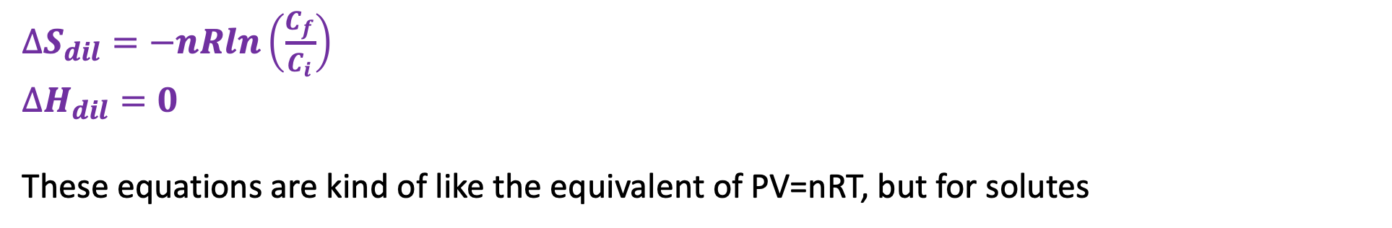
Week 11 – Entropy (and enthalpy) of dilution
$∆S_{dil}=−nRln\left(\frac{C_{f}}{C_{i}}\right)$
$∆H_{dil}=0$
These equations are kind of like the equivalent of PV=nRT, but for solutes

Slide 43
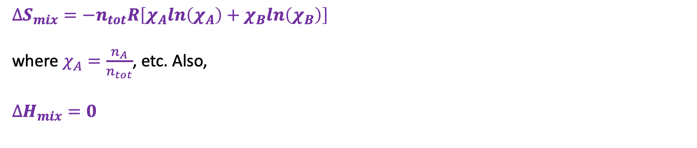
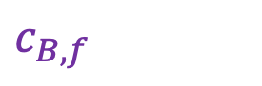
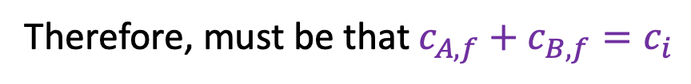
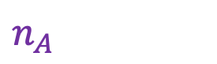
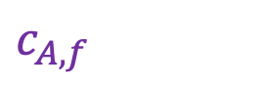
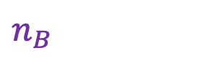
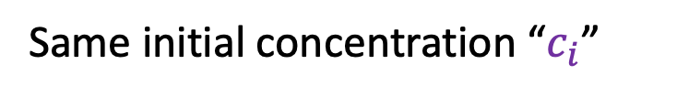
Week 11 – Entropy of mixing
$$n_{A}$$
$$c_{B,f}$$
$$n_{B}$$
$$c_{A,f}$$
Same initial concentration “$c_{i}$”
Therefore, must be that $c_{A,f}+c_{B,f}=c_{i}$
$∆S_{mix}=−n_{tot}R\left[χ_{A}ln\left(χ_{A}\right)+χ_{B}ln\left(χ_{B}\right)\right]$
where $χ_{A}=\frac{n_{A}}{n_{tot}}$, etc. Also,
$∆H_{mix}=0$

Slide 44
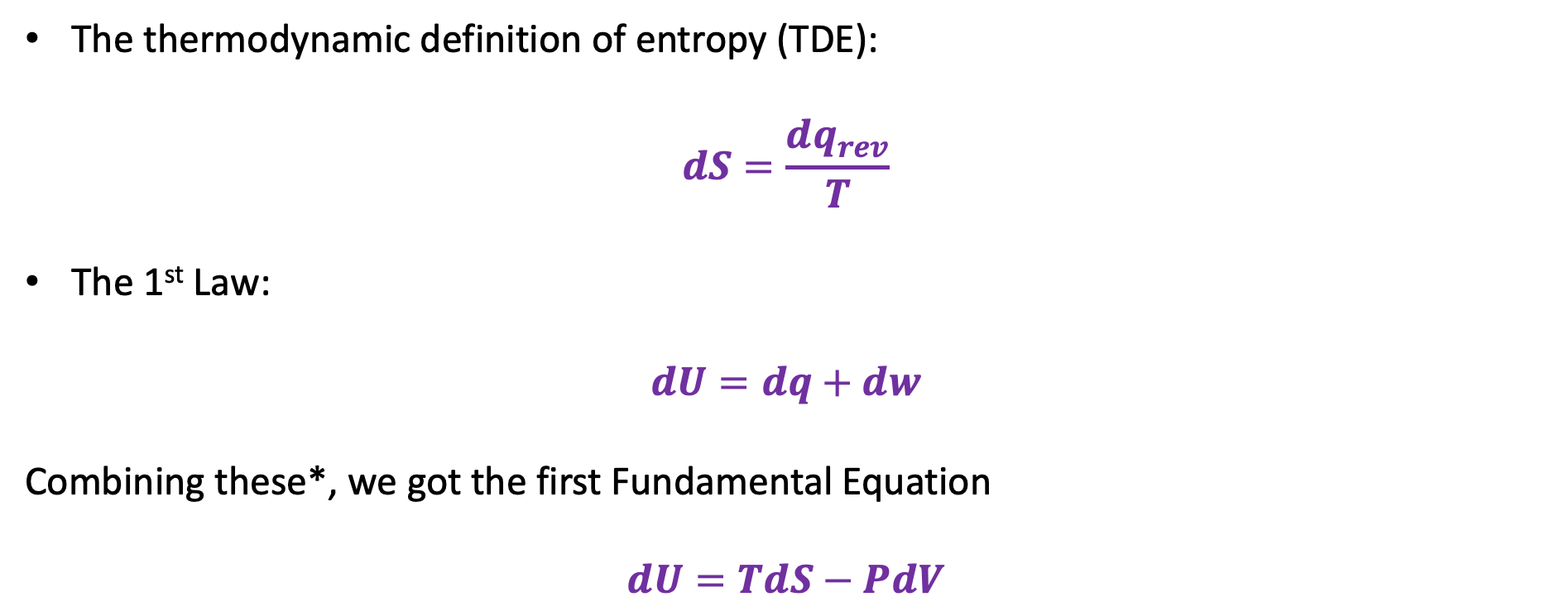
Week 11 – How the “Fundamental Equations” came about
The thermodynamic definition of entropy (TDE):
$$dS=\frac{dq_{rev}}{T}$$
The 1st Law:
$$dU=dq+dw$$
Combining these*, we got the first Fundamental Equation
$$dU=TdS−PdV$$
*Subject to conditions: reversible process with PV work only

Slide 45
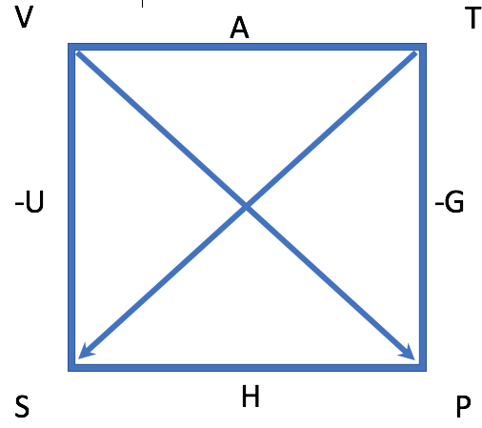
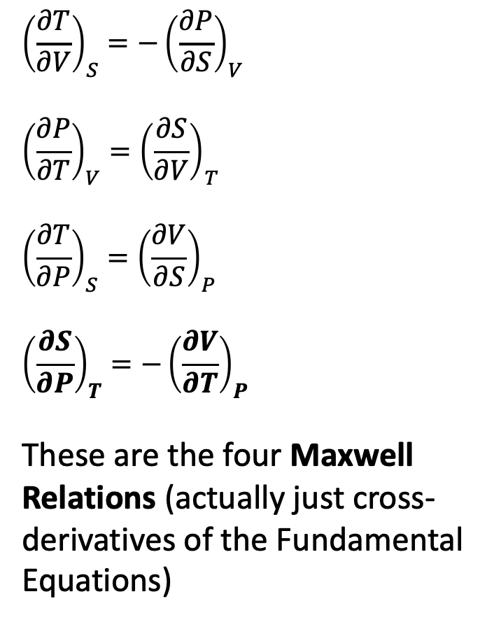

Week 11 – Using the box (actually we started this in Week 10)
$${\left(\frac{∂T}{∂V}\right)}_{S}=−{\left(\frac{∂P}{∂S}\right)}_{V}$$
$${\left(\frac{∂P}{∂T}\right)}_{V}={\left(\frac{∂S}{∂V}\right)}_{T}$$
$${\left(\frac{∂T}{∂P}\right)}_{S}={\left(\frac{∂V}{∂S}\right)}_{P}$$
$${\left(\frac{∂S}{∂P}\right)}_{T}=−{\left(\frac{∂V}{∂T}\right)}_{P}$$
These are the four Maxwell Relations (actually just cross-derivatives of the Fundamental Equations)
$dU=TdS−PdV$
$dH= …$
$dG= …$
$dA= …$
These are the four Fundamental Equations

Slide 46

Week 12 – Thermodynamics of burning a mole of coal
Heat fuels an electricity-generating power plant
Only about 40% gets turned into useful electrical energy
394 kJ/mol heat
160 kJ/mol electrical energy
Furnace

Slide 47


Week 12 – Thermodynamics of burning a mole of coal
$$C\left(s\right)+O_{2}\left(g\right)→CO_{2}\left(g\right)$$
$$∆G=∆G_{rxn}^{o}+∆G_{dil}$$
Cost to somebody in the future
$$115\frac{kJ}{mol}$$
Furnace

Slide 48





Week 12 – Gibbs energy of a reaction mixture ($A→B$)
${G=G}^{o}+∆G_{mix}$
$$G^{o}$$
$$∆G_{mix}$$
$$G$$
$G$ < $G^{o}$ because $∆G_{mix}<0$

Slide 49



Week 12 – Gibbs energy of a reaction mixture ($A→B$)
The slope of the Gibbs energy along the reaction path told us how far a reaction will proceed:
As long as ${\left(\frac{∂G}{∂ε}\right)}_{rxn}<0$, the reaction moves forward (makes more $B$)
As long as ${\left(\frac{∂G}{∂ε}\right)}_{rxn}>0$, the reaction moves backward (makes more $A$)
If ${\left(\frac{∂G}{∂ε}\right)}_{rxn}=0$, the reaction is at equilibrium
At equilibrium, there’s a certain ratio of B to A. That’s the equilibrium constant, K
$$ε$$

Slide 50



Week 12 – Chemical potentials – they’re just slopes in the $n_{A}$, $n_{B}$ state space
$$μ_{A}≡{\left(\frac{∂G}{∂n_{A}}\right)}_{n_{B}, T,P}$$
$$μ_{B}≡{\left(\frac{∂G}{∂n_{B}}\right)}_{n_{A}, T,P}$$
$$μ_{A}≡{\left(\frac{∂G}{∂n_{A}}\right)}_{n_{B}, T,P}$$

Slide 51


Week 12 – Chemical potentials and equilibria
$$ε$$
We said
$$μ_{A}=μ_{A}^{o}+RT ln{(a}_{A})$$
(you can find $μ_{A}^{o}=∆G_{f}^{o}(A)$ in tables). Similar for B.

Slide 52


Week 12 – Chemical potentials and equilibria
$$ε$$
Defined ${\left(\frac{∂G}{∂ε}\right)}_{rxn,T,P}≡∆G_{rxn}(ε)$
Then, we
showed that $∆G_{rxn}=∆G_{rxn}^{o}+RT ln⁡(Q_{rxn})$ anywhere along the reaction path
showed that $∆G_{rxn}^{o}=−RT ln⁡(K)$ at equilibrium

Slide 53

Week 12 – How $∆G_{rxn}(ε)$ depends on reaction stoichiometry
What if the reaction path is $A→2B$?
$$∆G_{rxn}\left(ε\right)=∆G_{rxn}^{o}+nRT ln{(Q}_{rxn})$$
where $Q_{rxn}≡\frac{a_{B}^{2}}{a_{A}}$. As before, at equilibrium we know that $∆G_{rxn}\left(ε\right)=0$, with particular values of $a_{A}$ and $a_{B}$, hence
$$∆G_{rxn}^{o}+nRT ln(K)$$
Which means … that if you measure $K$ in the lab, you can figure out $∆G_{rxn}^{o}!$

Slide 54

Week 12 – A generalization of chemical potentials
$$μ_{A}=μ_{A}^{o}+RT ln\frac{a_{A}}{a^{o}}$$
The $μ_{A}^{o}$ part is $∆G^{o}$ of the substance A – the Gibbs energy of a pure, unmixed substance in what we have been calling its standard state
The $nRT ln\frac{a_{A}}{a^{o}}$ part takes into account the mixing or dilution
The generic name for $a_{A}$ is defined as the substance’s activity:
If A is a solute, $a_{A}=$ $C_{A}$ (concentration of A), and $a^{o}=1 \underline{M}$
If A is a gas, $a_{A}=$ $P_{A}$ (partial pressure of A, and $a^{o}=1 bar$
If A is a solvent, $a_{A}= χ_{A}$ (mole fraction of A) and $a^{o}=1$

Slide 55

Week 12 – A generalization of chemical potentials
$$μ_{A}=μ_{A}^{o}+RT ln\frac{a_{A}}{a^{o}}$$
The $μ_{A}^{o}$ part is $∆G^{o}$ of the substance A – the Gibbs energy of a pure, unmixed substance in what we have been calling its standard state
The $nRT ln\frac{a_{A}}{a^{o}}$ part takes into account the mixing or dilution
The generic name for $a_{A}$ is defined as the substance’s activity:
If A is a solute, $a_{A}=$ $C_{A}$ (concentration of A), and $a^{o}=1 \underline{M}$
If A is a gas, $a_{A}=$ $P_{A}$ (partial pressure of A, and $a^{o}=1 bar$
If A is a solvent, $a_{A}= χ_{A}$ (mole fraction of A) and $a^{o}=1$
In case you run into it: thermodynamicists like to fudge those definitions to force $μ_{A}$to be equal to $μ_{A}^{o}+RT ln\frac{a_{A}}{a^{o}}$. So for example they’ll say (for a solute) that $a_{A}=$ $C_{A}$ $×$ $γ$, where $γ$ is the fudge factor.

Slide 56

Week 12 – Derivation of the Clapeyron equation
$dG_{gas}=−S_{gas}dT+V_{gas}dP$
$dG_{liq}=−S_{liq}dT+V_{liq}dP$
In going from A to B, it must be that $dG_{gas}=dG_{liq}$
Then you showed how this led to Clapeyron
$$\frac{dP}{dT}=\frac{∆H_{vap}}{T ∆V_{vap}}$$
B
A

Slide 57





Week 12 – Osmotic effect and osmotic pressure
Chamber X is a 1 M solution of NaCl(aq). Chamber Y is pure water.
X
Y
$$∆P$$
X
Y
$$H_{2}O$$
$$(+solute)$$
$$H_{2}O\left(l\right)$$
$$(pure)$$
$$H_{2}O$$
$$(+solute)$$
$$H_{2}O\left(l\right)$$
$$(pure)$$
Osmotic effect
Osmotic pressure

Slide 58











Week 13 – Reversible non-PV work
-
+
-
+
$$e^{−}$$
-
Up-gradient
$$w^{′}>0$$
Spontaneous
$$w^{′}<0$$
+
So our formula is
$$w^{′}=nF ∆φ$$
Example: Two moles of protons are moved up-gradient 0.1 V. What’s the work?
$$w^{′}=2 × 9.65×{10}^{4}× 0.1=19,300 J=19 kJ$$
-
+
-
+
$$H^{+}$$
-
Spontaneous
$$w^{′}<0$$
Up-gradient
$$w^{′}>0$$
+
-
+
$$φ$$
$$∆φ$$
$$∆z$$
$$z$$

Slide 59



Week 13 – Reversible non-PV work equals the change in Gibbs energy!
State “X”
(Higher G)
$\text{U}\text{p}\text{−}\text{gradient}$
(not spontaneous)
$${dw}^{′}=dG>0$$
Down-gradient
(spontaneous)
$${dw}^{′}=dG<0$$
State “Y”
The relationship ${dw}^{′}=dG$ holds as long as the work is carried out reversibly and at constant temperature and pressure
Similar statements apply to finite changes: $w^{′}=∆G$ as long as the work is carried out reversibly and at constant temperature and pressure

Slide 60

Week 14 – Epistemology of thermodynamics
True because we say so (i.e., by definition, or by choice of experimental condition)
Isobaric conditions: $P=constant$
Isothermal conditions: $T=constant$
Isochoric conditions: $V=constant$
Mechanical reversibility: $P_{surr}$ (AKA $P_{ex}$) $≈P$
Thermal reversibility: $T_{surr}≈T$
$H≡U+PV$, $G≡H−TS$, $A≡U−TS$

Slide 61

Week 14 – Epistemology of thermodynamics
True because math works
How we know that $H$, $G$, and $A$are state functions
How path independence => state function
Total differential: If $Z = W + XY$, then $dZ =dW+d(XY)$
Product Rule: $d\left(XY\right)=XdY+YdX$
Quotient Rule $d\left(\frac{X}{Y}\right)=$ $\frac{1}{Y} dX+$ $X(−\frac{1}{Y^{2}})dY$ (Application to Gibbs-Helmholtz)
Cross-derivative test: If $dZ=AdX+BdY$ and ${\left(\frac{∂A}{∂Y}\right)}_{X}={\left(\frac{∂B}{∂X}\right)}_{Y}$, then $Z\left(X,Y\right)$ exists
No-brainer, Euler Chain, inverter: ${\left(\frac{∂X}{∂Y}\right)}_{Z}=1/{\left(\frac{∂Y}{∂X}\right)}_{Z}$

Slide 62

Week 14 – Epistemology of thermodynamics
True because of how nature works (we think)
1st Law: $dU=dq+dw$
2nd Law: All spontaneous processes have $dS_{tot}>0$
Thermodynamic definition of entropy: $dS=\frac{q_{rev}}{T}$

Slide 63


Week 14 – Temperature-composition diagrams
$T_{A}^{∗}$, $T_{B}^{∗}$ describe normal boiling temperatures of pure $A$ and $B$. $A$ more is volatile than $B$, so $T_{A}^{∗}$< $T_{B}^{∗}$
Let $x_{A}$ be the mole fraction of A in the liquid
Let $y_{A}$ be the mole fraction of A in the gas
At the temperature indicated, if two phases are present, what must be their composition?
$y_{A}$
$x_{A}$

Slide 64

Week 14 – Self-consistent (“coherent”) unit systems
SI and atomic units are coherent unit systems
The argument of an exponential is always dimensionless
The “SI guarantee” (or “au guarantee”)

